Slide 1

OWL MIND
Lucas Haesaert

Slide 2
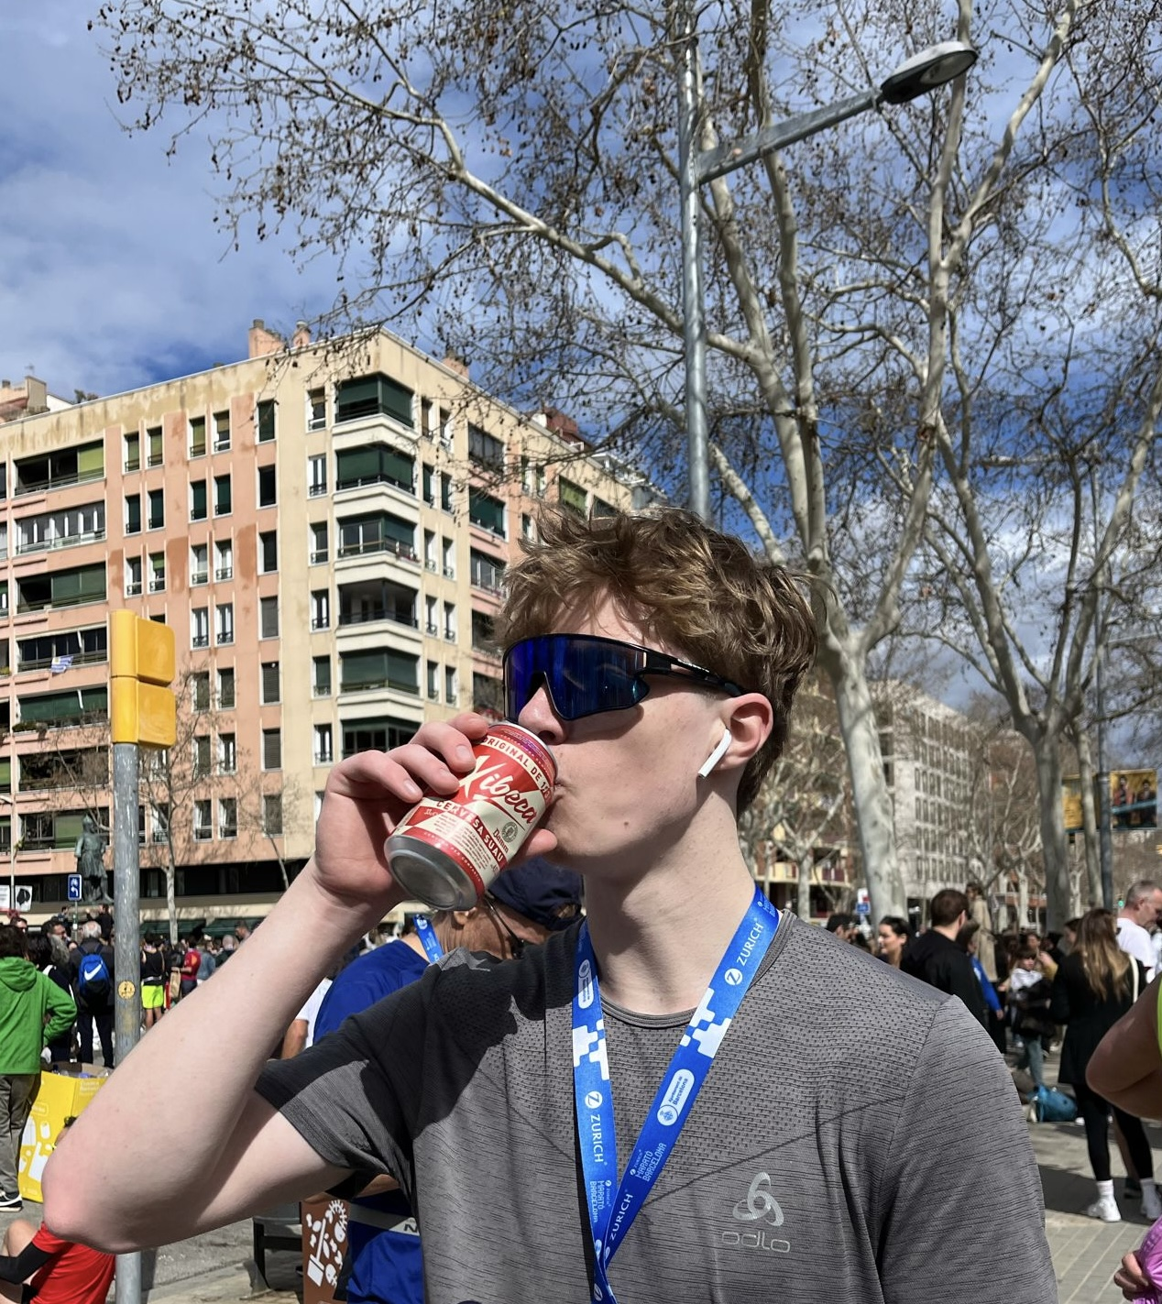
Founder

Slide 3
EXEC SUMMARY
Problem – “Professionals in service firms want to use AI effectively, but most lack practical training and tailored guidance, leading to superficial adoption and missed opportunities for productivity and innovation”
Solution – Educational platform
Segmentation & Validation – service firms (Employees & managers)
Value proposition – Integrated educational platform and AI help
Business Model – 3 streams of income
Market size & Growth
Competitive landscape
Financials
Go to Market
Risks – What is the riskiest hypothesis? – That no integrative solution will take over completely in the foreseeable future as use cases are too personal

Slide 4

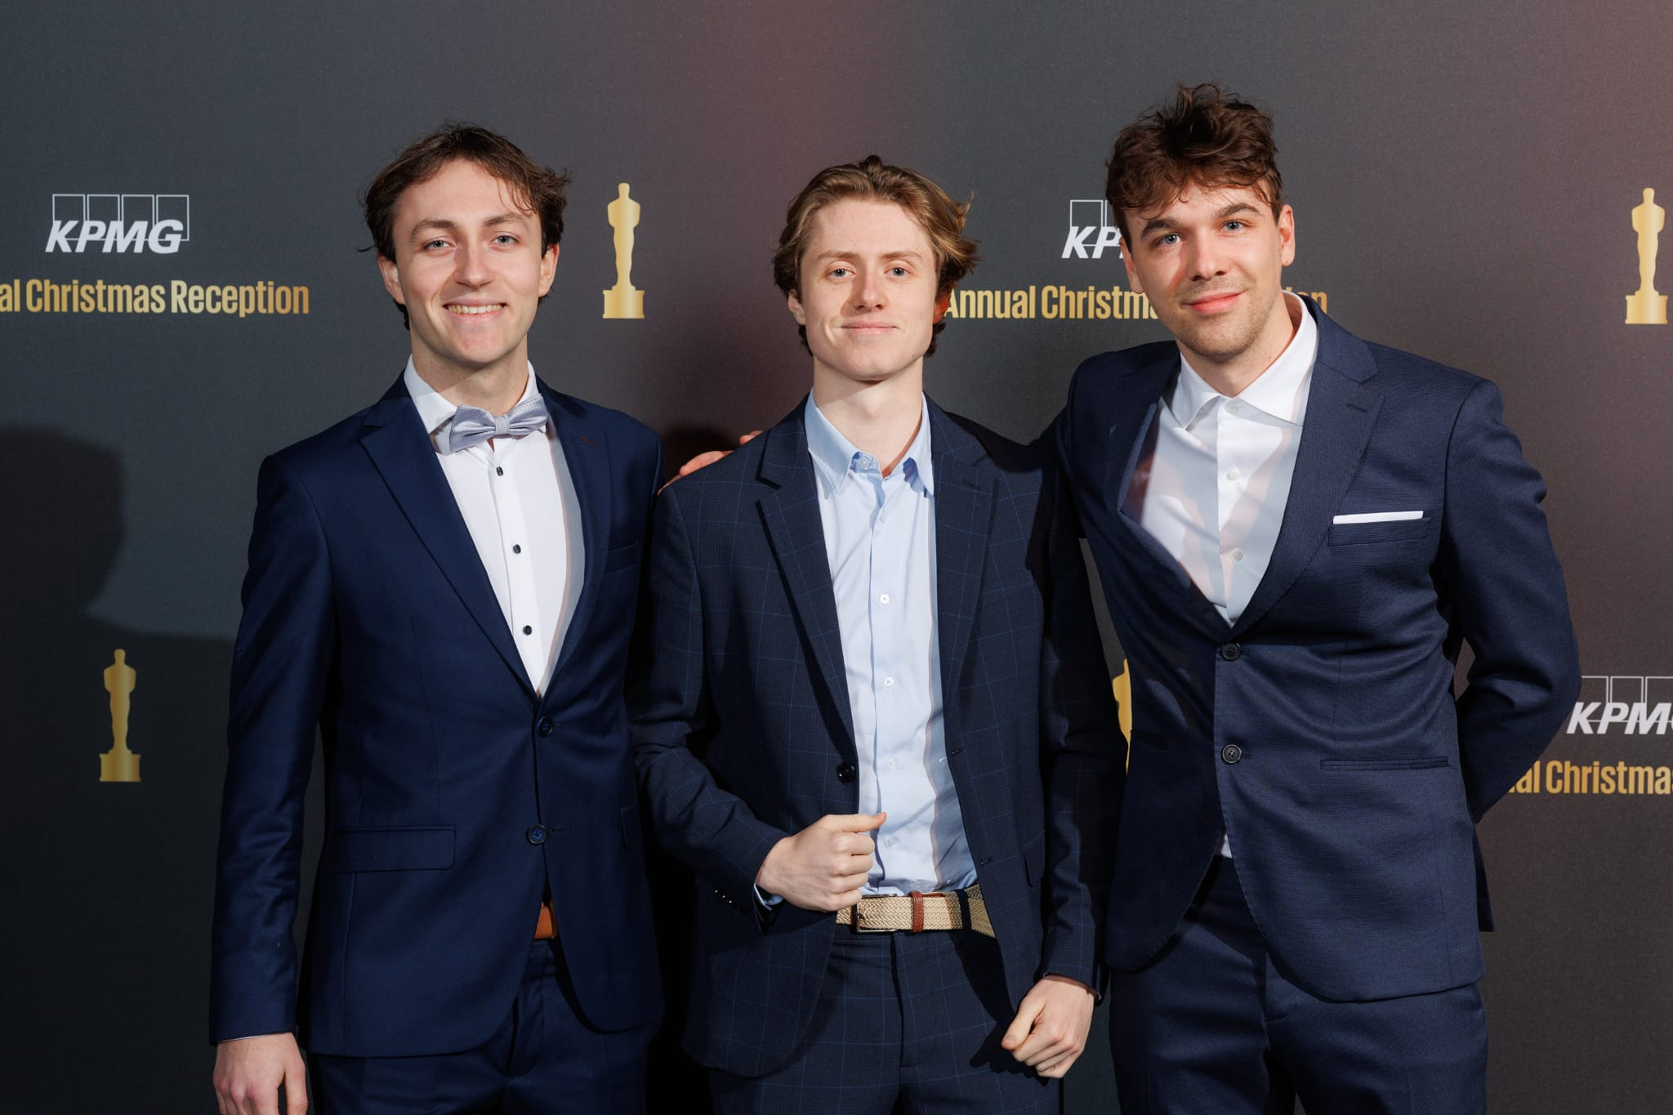
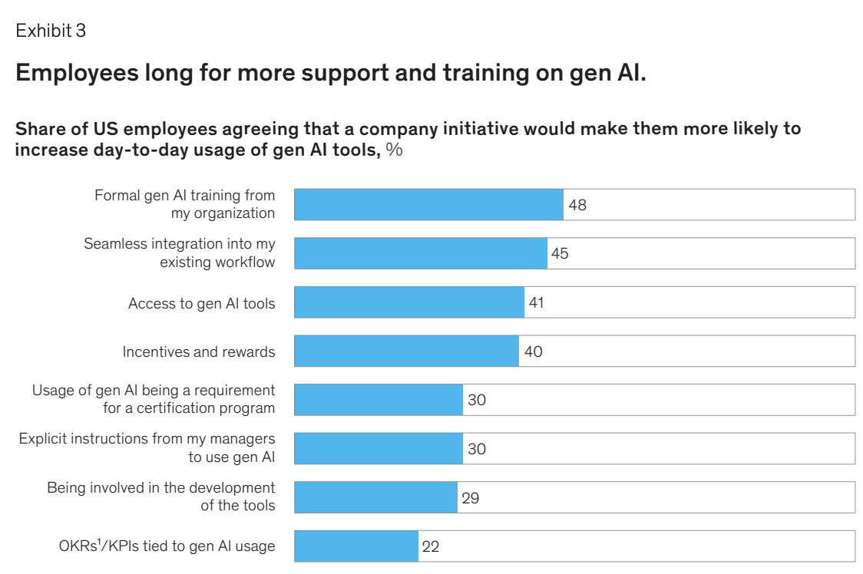
Problem
Refine?
“Professionals in service firms want to use AI effectively, but most lack practical training and tailored guidance, leading to superficial adoption and missed opportunities for productivity and innovation.”
Not alone in this struggle
My own experience
Employees using AI superficially
Improvised use cases
Restriction > empowerment
Too much of the work I had to do felt replaceable by AI / I felt could further be Aided by AI that I was doing
Examples - of where AI could have …
Market research
Competitive reports
Web scraping
Gathering and synthesizing information
Organizing excels
…
(nevertheless had a great experience at KPMG)
Source

Slide 5
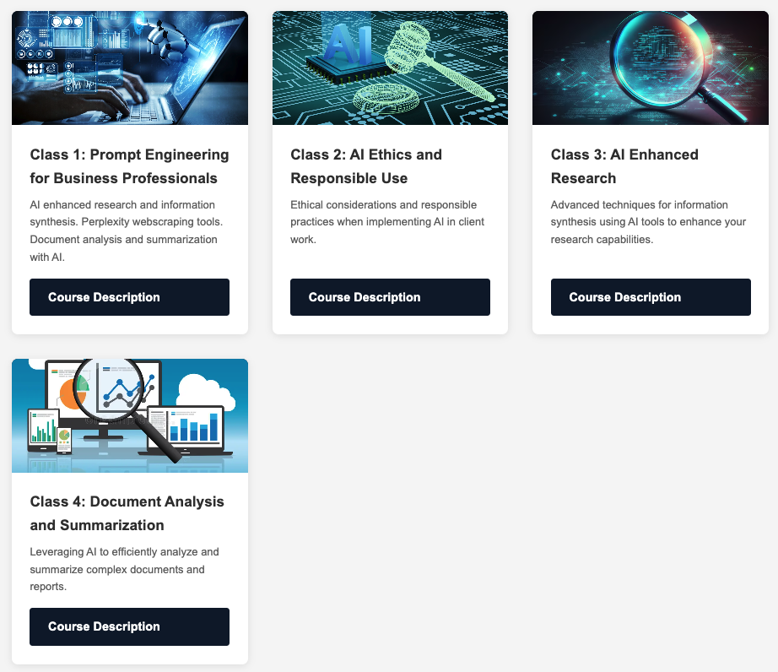
Solution
AI Education platform tailored to the needs of service professionals
This would include:
1. AI Use cases
2. General AI related courses
Risk and Responsible use
Prompt Engineering & XML tags and how to use them
…
3. Specific classes
Building MVPs using AI
AI leveraged Market research
AI for financial analysis …
Demo
Each course can include:
Specific topic related prompts
Tools (from partners or not)

Slide 6
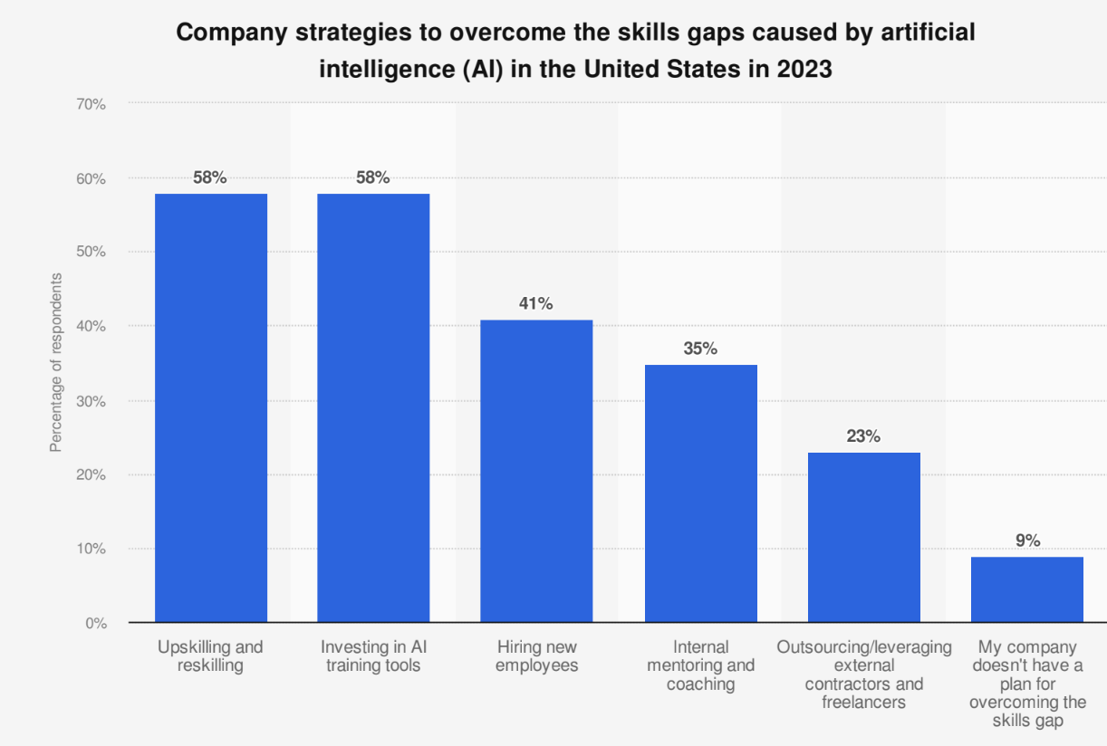
Customer segment & Validation
Targeted segment:
Any service company or company with employees doing long office hours
Ad to go to market
20 interviews
6 Employees
- “a lot of us don’t know how to maximize results just yet”
“Many companies give employees a budget for trainings with a simple justification”
5/6 - want to improve and increase their AI usage
5/6 – say that there are no current trainings available or that the ones available restrict them rather than empower them
14 Managers
9/14 - mentioned AI when asked what skills they would like their employees to improve on
13/14 – would like to improve the way AI is used in their workspace
Company strategies to overcome skill gaps
“There were complaints from peers about the ChatGPT integration being vague and it seems like just a blind trend following”
PWC x Statista – 2024

Slide 7





Value proposition
Education platform
Human support
Partnerships with tool providers
General AI related courses
Specific classes
Workshops
Risks and responsible AI use
Building MVPs for non-technical profiles
+
+
Tool implementation
Introduction to prompt engineering
AI leveraged Market research
…
AI for financial analysis …
Individual sessions

Slide 8
Business model
Revenue streams
Education platform
Year 1
Demo Tier
Essentials
$15/ user / month
Professional Tier
$20 / user / month
Human support
Workshops – 500$ per attendee
The goal of these workshops would be two fold:
To understand the clients needs (ex. Finding areas of inefficiency)
To codevelop solutions with them fixing inefficiency issues with agents professionally implemented by us
Year 2
Partnerships with tool providers
Year 2-3
Leveraging existing client base to generate affiliate revenue from the partnerships we have by implementing tools made by external parties

Slide 9
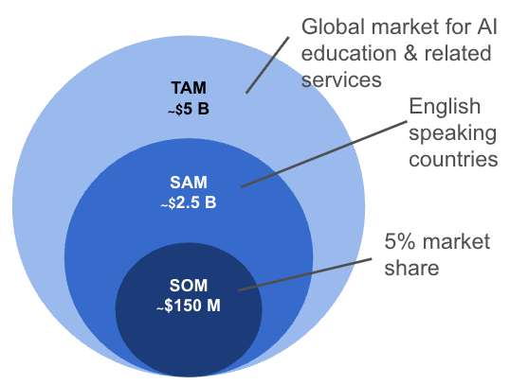
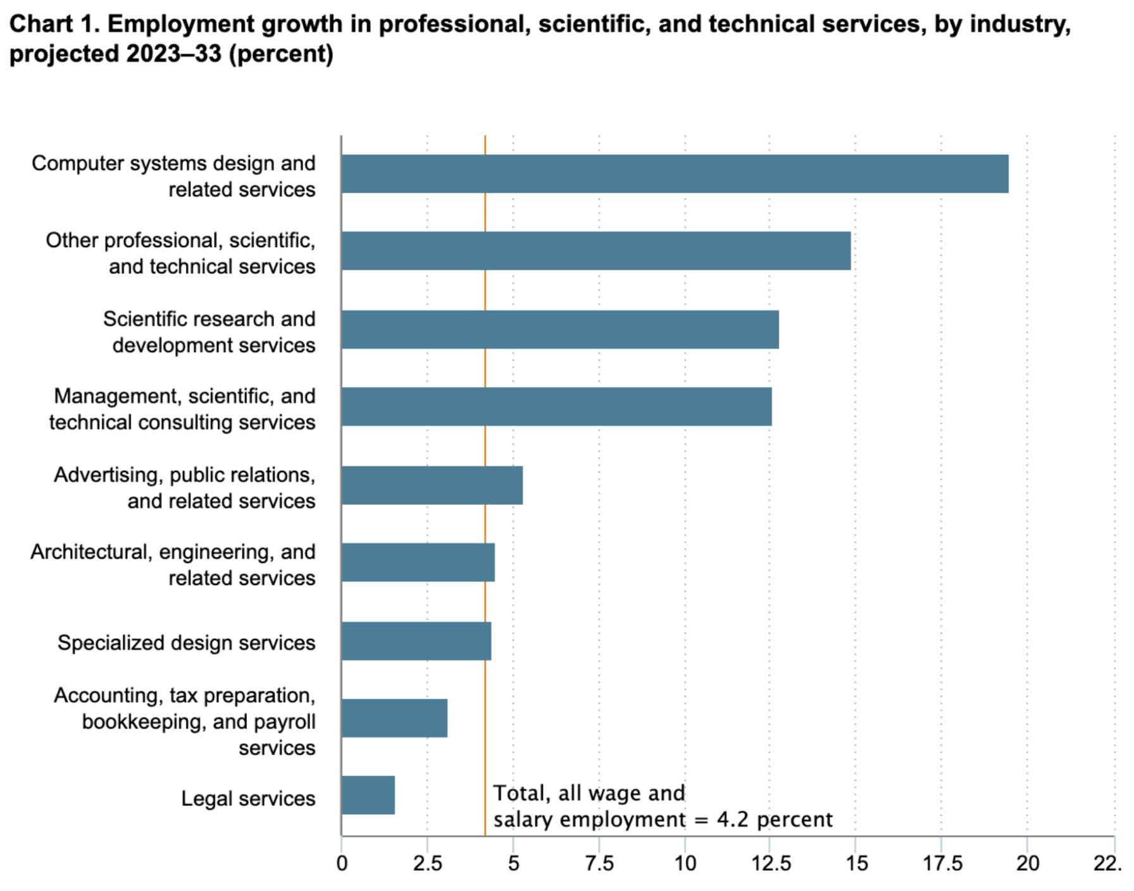
Market & TAM/SAM/SOM
Sizeable market
Grandview Inc, own calculations
Growth
Bureau of labor statistics

Slide 10
Competitive Landscape
Does this already exist?
Viability/ Feasibility

Slide 11
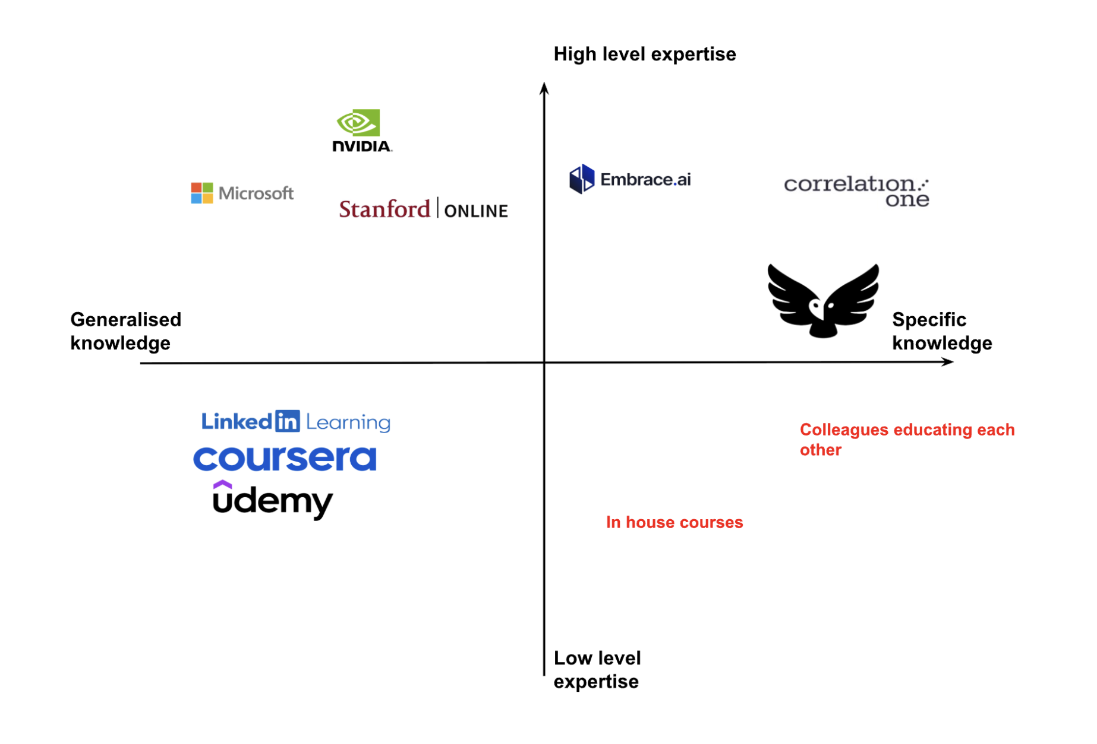
Competitive Landscape
Reduce text
Positioning
Competitor type | How OWL MIND would differentiate
Existing Education Platforms | Mainly give long courses that are aimed at people that have time The courses are not always directly applicable to business-related jobs These platforms do not necessarily care to service the needs of individual clients as they are too big to do so
Conglomerates | Conglomerates like Microsoft push their own software and do not necessarily act in their clients' best interest Microsoft has been pushing Copilot subscriptions to its existing clients Many clients think the software is not as good as expected Conglomerates make clients dependent on one ecosystem, which prevents them from leveraging the best of all worlds Conglomerates are
Start ups | Most start-ups are not aiming their service directly at professional service firms, where we could differentiate in making our applications as relevant as possible for that type of company.
Other forms of competition | Many companies have been trying to develop the expertise in-house. During my internship at KPMG, I attended a workshop related to AI, yet the quality was still in its infancy, and I was teaching people more about use cases than learning myself.

Slide 12
Financials
How much will we earn?
Viability

Slide 13
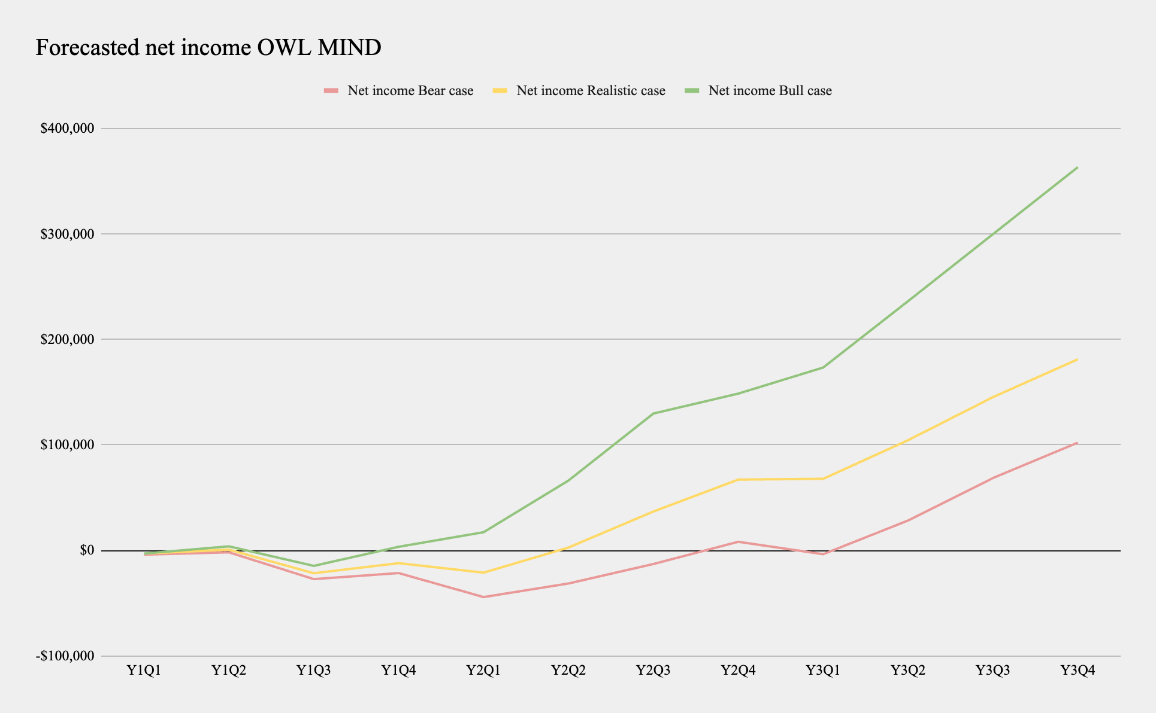
Financials
Based on the 3 revenue streams business model: Assumptions
Bear case:
Realistic case:
Bull case:

Slide 14
Go-to-market plan
How are we bringing this to the market?
Feasibility

Slide 15
Go-to-market plan
Short or long term?
As of today:
Month 1 – start rolling out demo for free to customers & start sign ups for waitlist of extended service
Month 2 – roll out first tier with essentials courses
…
Phase 1: Education Platform Development (Year 1)
In the first year, we will focus on building our core education platform with generic AI courses tailored to professional services contexts. This involves creating foundational content covering prompt engineering, AI ethics, document analysis, and financial applications. During this phase, we'll develop the technical infrastructure, establish our brand identity, and begin acquiring our first clients through targeted marketing to mid-sized professional services firms. By the end of Year 1, we aim to have a fully functional platform with 10-15 high-quality courses and our first 100 enterprise users.
Phase 2: Implementation Services Expansion (Year 2)
Building on our educational foundation and growing expertise, we'll expand into implementation services in our second year. This evolution will involve hiring specialized consultants who can deliver customized workshops and provide hands-on implementation support. We'll develop methodologies for AI integration that address specific workflows within professional services firms. By Year 3, we should have a robust catalog of implementation case studies and testimonials, establishing our reputation as not just educators but also trusted implementation partners for AI adoption.
Phase 3: Strategic Partnerships Development (Year 3)
By Year 3, with a substantial client base and proven implementation expertise, we'll be positioned to form strategic partnerships with leading AI companies. We'll leverage our market position to negotiate favorable terms with OpenAI, Microsoft, Anthropic, and other technology providers. These partnerships will create new revenue streams through affiliate relationships while giving our clients privileged access to cutting-edge AI tools. This phase completes our evolution into a full-service AI partner for professional services firms, creating a self-reinforcing ecosystem where our independence becomes our greatest asset.
Phase 4: Agent building tool (X)
The future belongs to AI agents; each employee will soon have specialized AI assistants handling their most repetitive and time-consuming tasks. Building on our three years of education, implementation, and partnership experience, we'll transition into developing a comprehensive agent-building platform specifically designed for professional services. While we'll initially expand our course offerings to include agent development and integration training, the transformative opportunity lies in creating an intuitive, secure platform that enables non-technical professionals to build, deploy, and manage custom AI agents safely.
This platform will leverage our deep understanding of professional services workflows, accumulated through years of client engagement, to offer pre-built templates and safeguards tailored to legal, accounting, and consulting environments. By democratizing agent development while maintaining enterprise-grade security and compliance standards, we position ourselves to capture the most significant wave of AI adoption. This evolution represents our ultimate value proposition: transforming from an AI education company into the essential infrastructure that powers the agent-driven future of professional work.

Slide 16
Risks & mitigation
Feasibility
How do we get the managers to benefit from the employees increase in productivity? - Instead of slacking more
Privacy issues (especially big 4)
Is there enough consumable information for employees to learn before having to start very complex courses

Slide 17
Final all encompassing slide of the businesses potential and growth

Slide 18
Index
Include extensive Indicies to use for questions

